Slide 1

Pricing Governance
Early days for most firms
Essential control mechanism
Impact on profitability
Cultural issues
Pricing Analytics
Data driven decision-making
Specialists v partners
Data hygiene
Financial literacy
Pricing & Profitability
Project
Pricing Execution
Art & science
Not simply an admin function
Skills development
Enhanced commerciality
Pricing Technology
Who is it built for?
What is it intended to do?
Does it make life easier or more difficult?
What is the ROI?
© Validatum 2022

Slide 2
Pricing Governance Framework…
Price Governance
PRICING CONTROL
LOW
HIGH
PROFIT
LOW
HIGH
© Validatum 2021
© Validatum 2022

Slide 3
Pricing Governance Framework…
Price Governance
PRICING CONTROL
LOW
HIGH
PROFIT
LOW
HIGH
© Validatum 2022

Slide 4
Pricing Governance
Early days for most firms
Essential control mechanism
Impact on profitability
Cultural issues
Pricing Analytics
Data driven decision-making
Specialists v partners
Data hygiene
Financial literacy
Pricing & Profitability
Project
Pricing Execution
Art & science
Not simply an admin function
Skills development
Enhanced commerciality
Pricing Technology
Who is it built for?
What is it intended to do?
Does it make life easier or more difficult?
What is the ROI?
© Validatum 2022

Slide 5
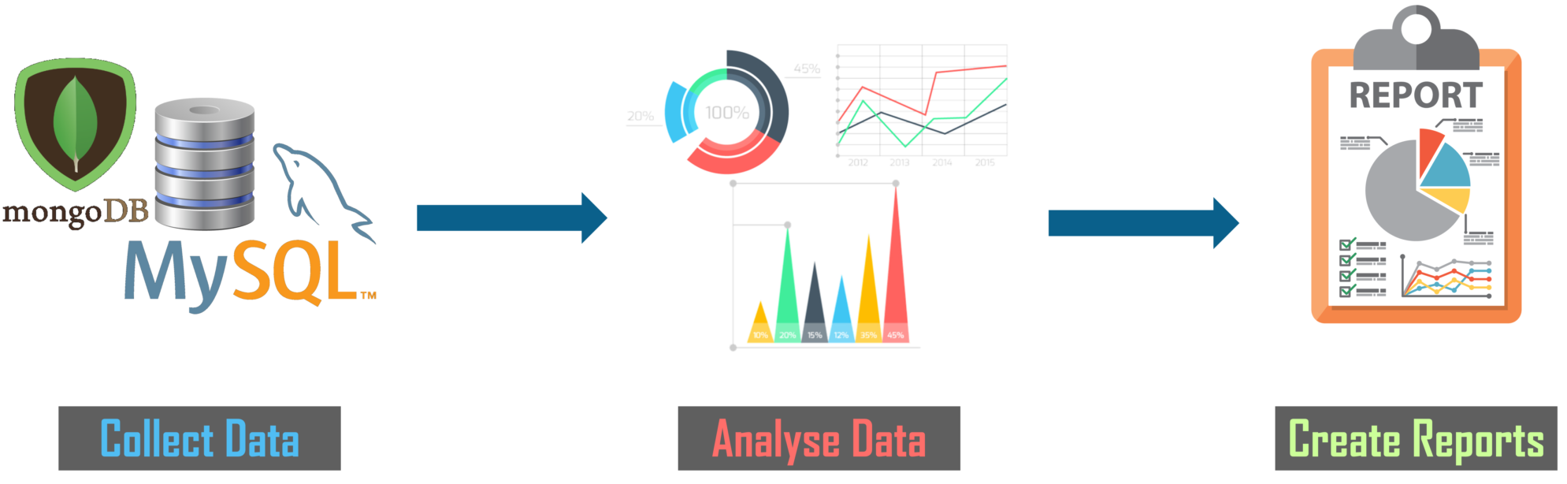
Confidential & Subject to Copyright

Slide 6
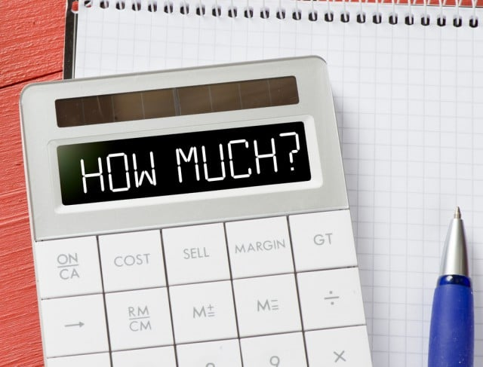

Lawyers
Analysts/Commercial Finance
Confidential & Subject to Copyright
Notes:
SHORT VERSION

Slide 7




Confidential & Subject to Copyright
Notes:
SHORT VERSION

Slide 8
Pricing Governance
Early days for most firms
Essential control mechanism
Impact on profitability
Cultural issues
Pricing Analytics
Data driven decision-making
Specialists v partners
Data hygiene
Financial literacy
Pricing & Profitability
Project
Pricing Execution
Art & science
Not simply an admin function
Skills development
Enhanced commerciality
Pricing Technology
Who is it built for?
What is it intended to do?
Does it make life easier or more difficult?
What is the ROI?
© Validatum 2022

Slide 9
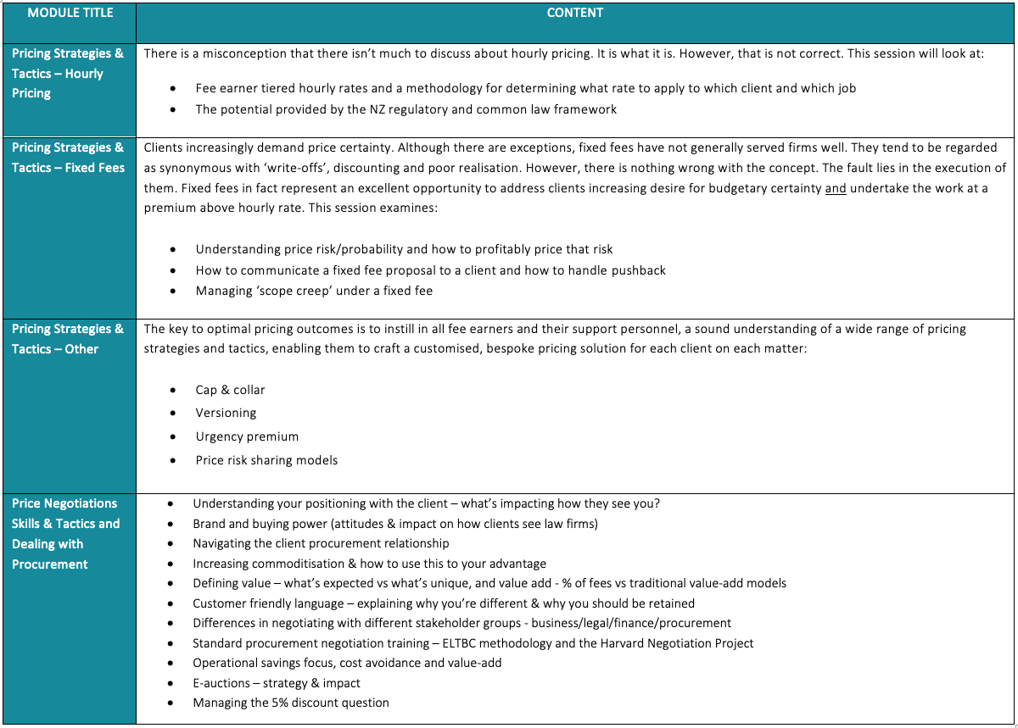
Confidential & Subject to Copyright

Slide 10
Pricing Governance
Early days for most firms
Essential control mechanism
Impact on profitability
Cultural issues
Pricing Analytics
Data driven decision-making
Specialists v partners
Data hygiene
Financial literacy
Pricing & Profitability
Project
Pricing Execution
Art & science
Not simply an admin function
Skills development
Enhanced commerciality
Pricing Technology
Who is it built for?
What is it intended to do?
Does it make life easier or more difficult?
What is the ROI?
© Validatum 2022

